Slide 1

MGMT 683: Final Project
Husam Saleh, Max McTigue, Alex Scarcelli, Mason Gillis

Slide 2





Meet the Team!
Husam Saleh
Max McTigue
Alex Scarcelli
Mason Gillis

Slide 3
Agenda
Meet Team and Agenda
Background and Dataset Description (Why Miami?)
Research into Superhost Issues
Summary Statistics
Formation of Business Problem
Proof that Problem Exists/ Description of initial graphs
Data Cleaning and Transformation
Initial tests and regression results
Final Model/ how we got there/ description of results
Interpretation/ What it means for Airbnb
Recommendations
Further analysis possibilities

Slide 4
Dataset Background
Airbnb Superhost Dataset
Criteria for Superhost:
(i) hosted at least 10 trips;
(ii) maintained a 90% response rate when responding to guests requests;
(iii) completed all confirmed reservations without cancellation; and
(iv) received a 5-star review at least 80% of the time
Three-month evaluation periods begin on January 1st, April 1st, July 1st, and October 1st. Each host’s Superhost status is reevaluated at the beginning of the subsequent evaluation period, usually within 10 days of the start of the evaluation period
Dataset covers eight Superhost evaluation periods: April (2017, 2018), July(2016, 2017), October(2016, 2017), and January(2017, 2018)

Slide 5
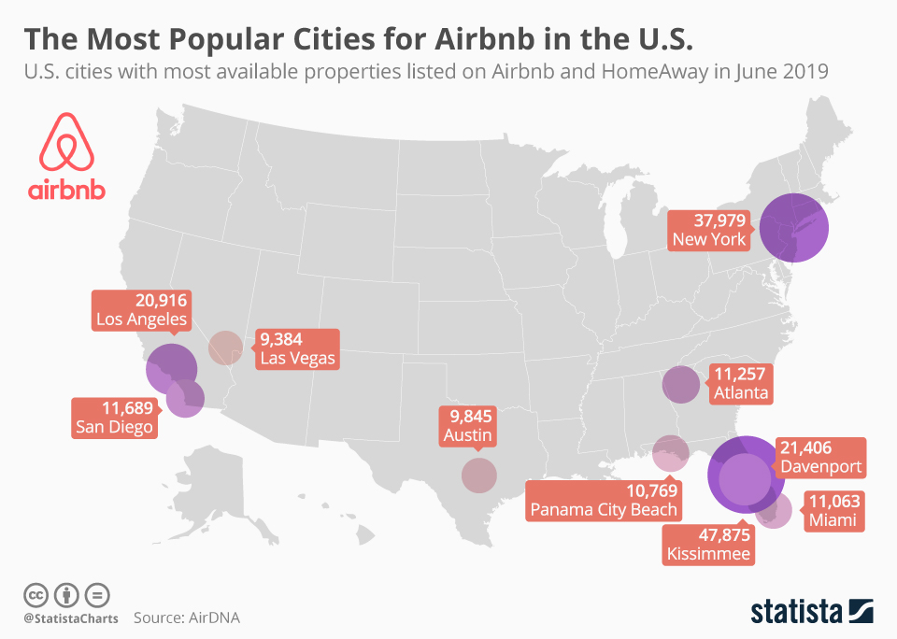
Dataset Background: Why Miami?
Miami is one of the most popular vacation destinations in the USA
One of the most expensive Airbnb markets in the world
Miami would be a good dataset to test models on due to large amount of Airbnb listings

Slide 6


Business Problem - Miami Dataset
How can we increase revenues for these listings to make obtaining Superhost worth it?
Are Superhosts underpricing listings?
Which listings are underpriced?
🏘

Slide 7
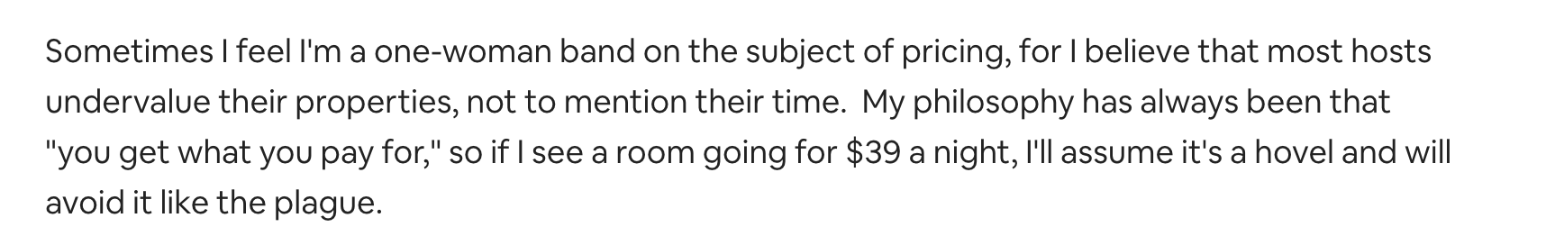
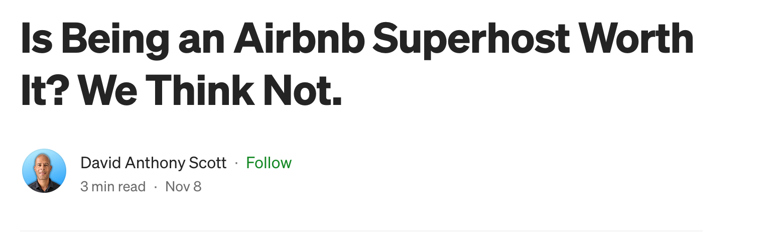
Research into Superhost Issues
Underpricing common issue among Superhosts in forums and articles
Many think becoming a Superhost is not worth it

Slide 8
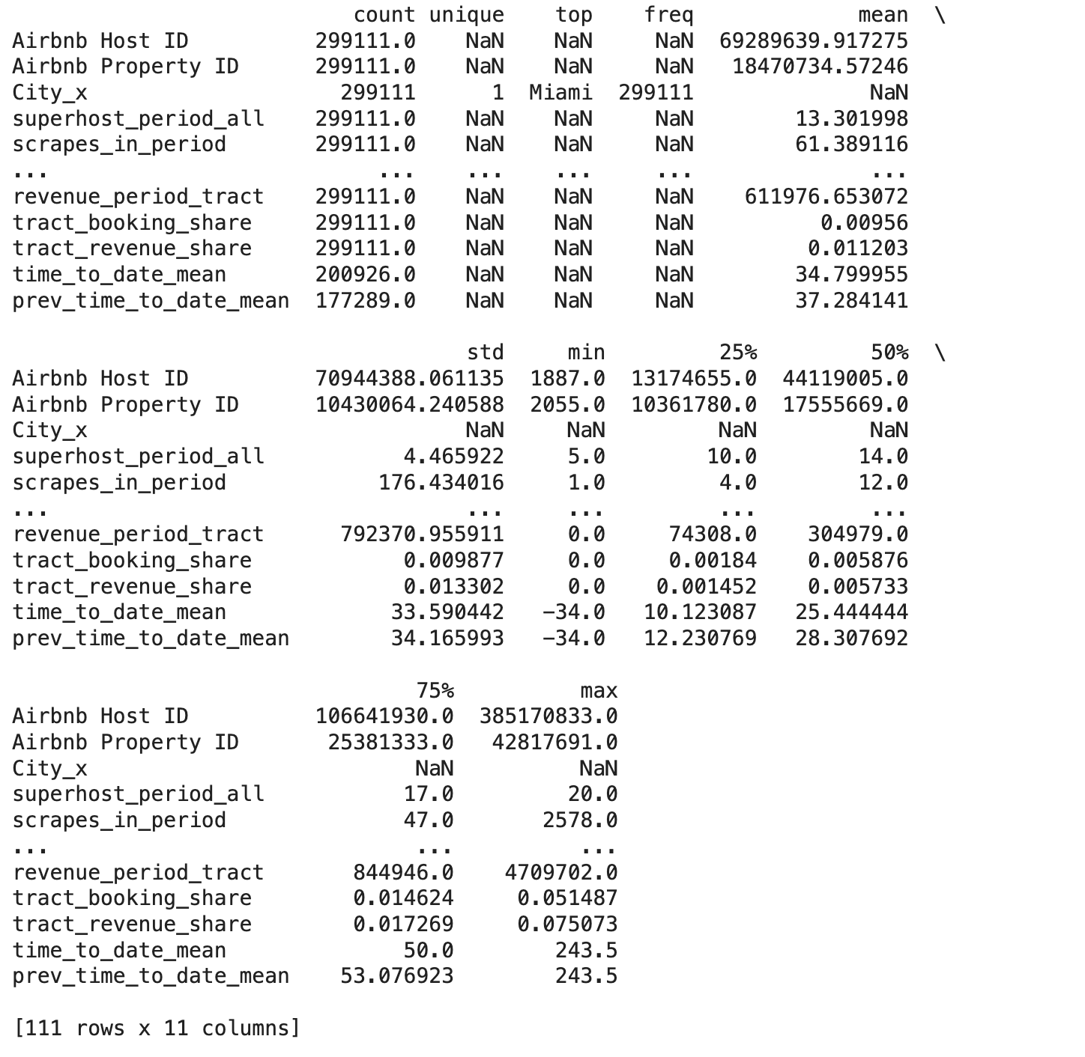
Dataset Summary Statistics

Slide 9
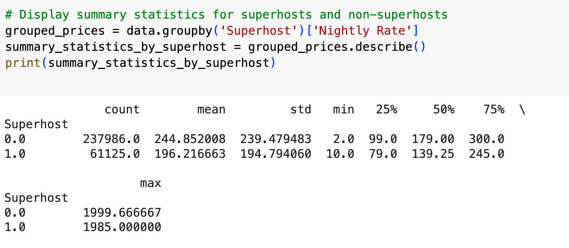
Superhost Pricing Summary Statistics

Slide 10
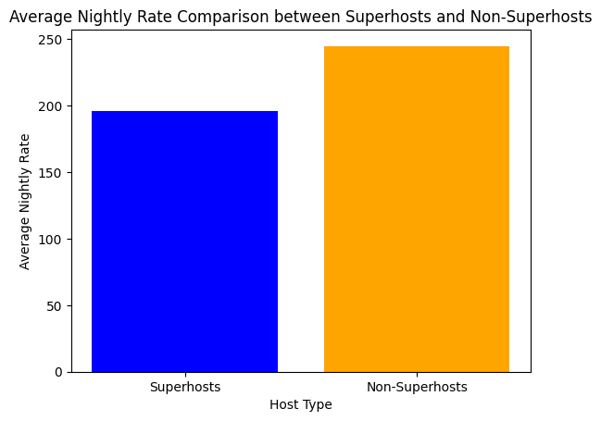
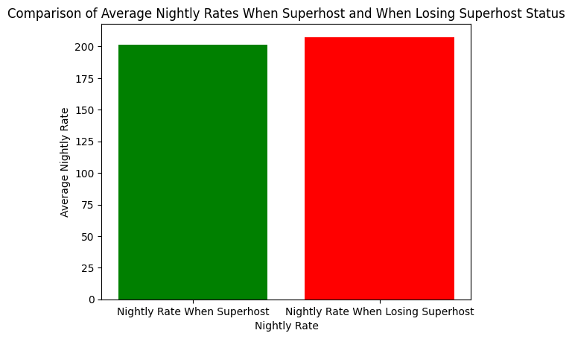
Proof of Problem

Slide 11
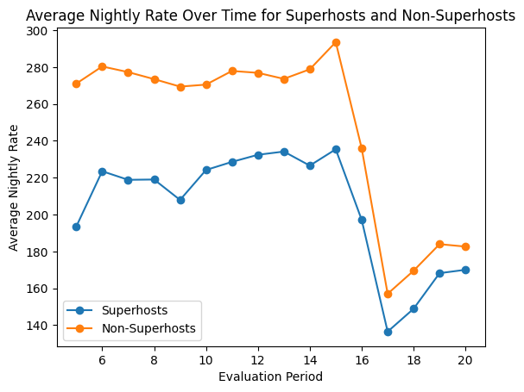
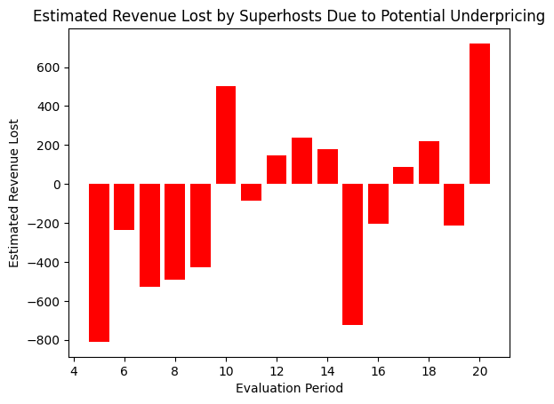
Problem Exploration

Slide 12
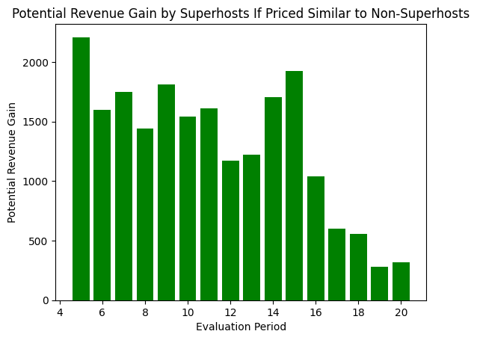
Problem Exploration

Slide 13
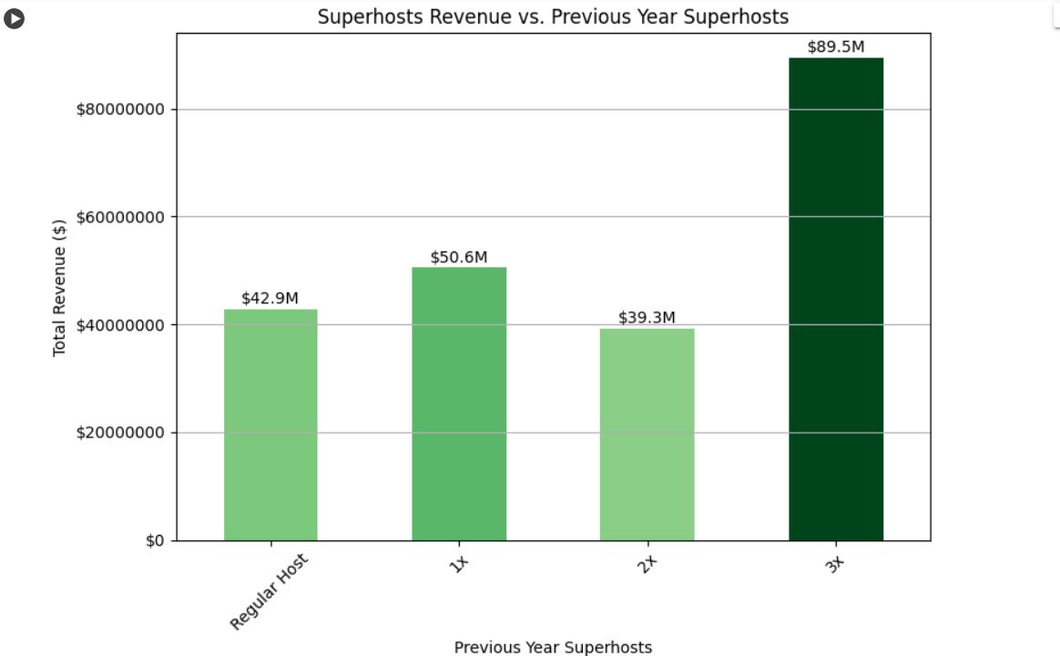
Superhosts Yearly Status Analysis

Slide 14
Company is not maximizing their revenue from Superhost listings
Being a Superhost has a positive and statistically significant impact on the variable revenue_period_city
Coefficient for variable “host_is_superhost_in_period” is 2939e+06 and P-value is close to zero indicating statistical significance

Slide 15
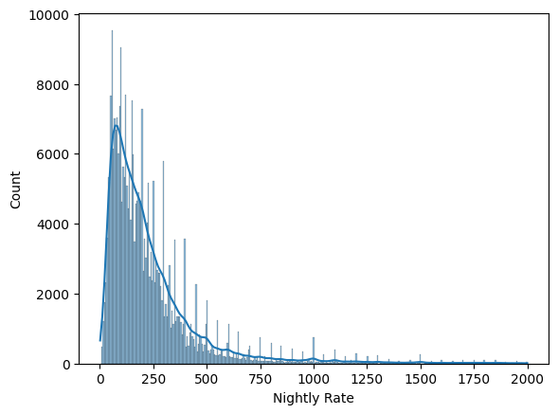
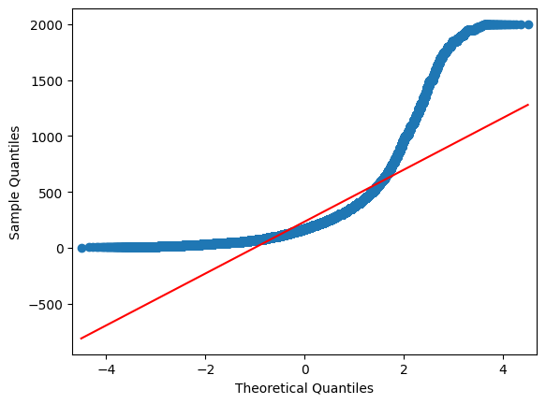
Data Cleaning and Transformation: Initial Tests

Slide 16
Data Cleaning and Transformation
Fix nan values
Fix skewed variables
Notable Variables with nan values or needed transformed (Not all Showed):
Nightly Rate
Booked Days
Booked Days Average Price
Bathrooms
Max Guests
Cleaning Fee
Number of Photos
Number of Reviews
Rating Overall
Occupancy Rate

Slide 17
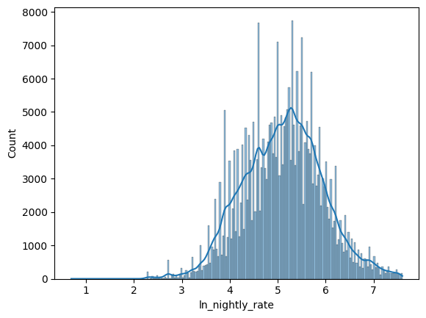
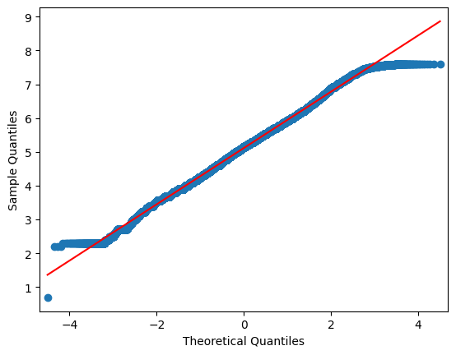
Post Transformation/ Fixed Missing Values

Slide 18
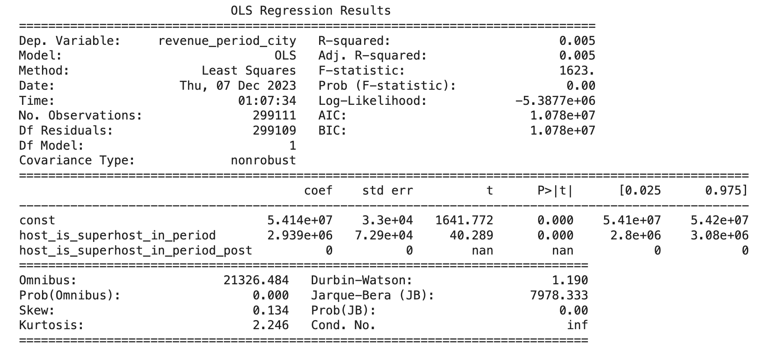
Model 1: Underpricing in Airbnb
Low R-Squared value (0.005) meaning the model explains only a small proportion of the variability in revenue_period_city
Suggests that factors other than superhost status might also influence revenue and there may be room for improvement in predicting or maximizing revenue
Coefficient suggests superhosts have a higher revenue_period_city by 2.939 million compared to non superhosts
Notes:
When

Slide 19
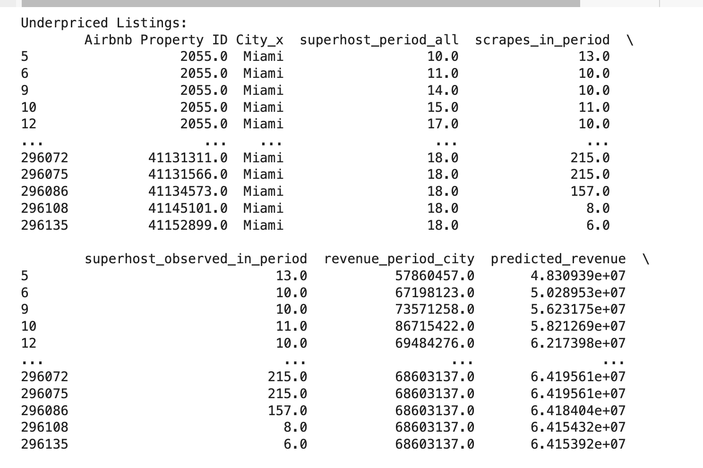
Data in Underpriced Listings

Slide 20
Observations with underpriced listings
Underpriced listings are primarily in Miami, with a common Airbnb Property ID (2055.0) appearing multiple times.
Superhost-related features ("superhost_period_all," "superhost_observed_in_period") and scraping activity ("scrapes_in_period") are present in the underpriced listings.
When looking at this data we can determine that the superhost_period_all feature is frequently present in underpriced listings

Slide 21
Recommendations to increase revenue in underpriced listings
Investigate the specific characteristics of listings with Airbnb Property ID 2055.0 to understand why they are consistently underpriced.
Consider adjusting pricing strategies for these listings to align with their predicted revenue, potentially increasing prices.
Explore the impact of superhost status on pricing and adjust incentives or promotions to encourage hosts to maintain or achieve superhost status

Slide 22
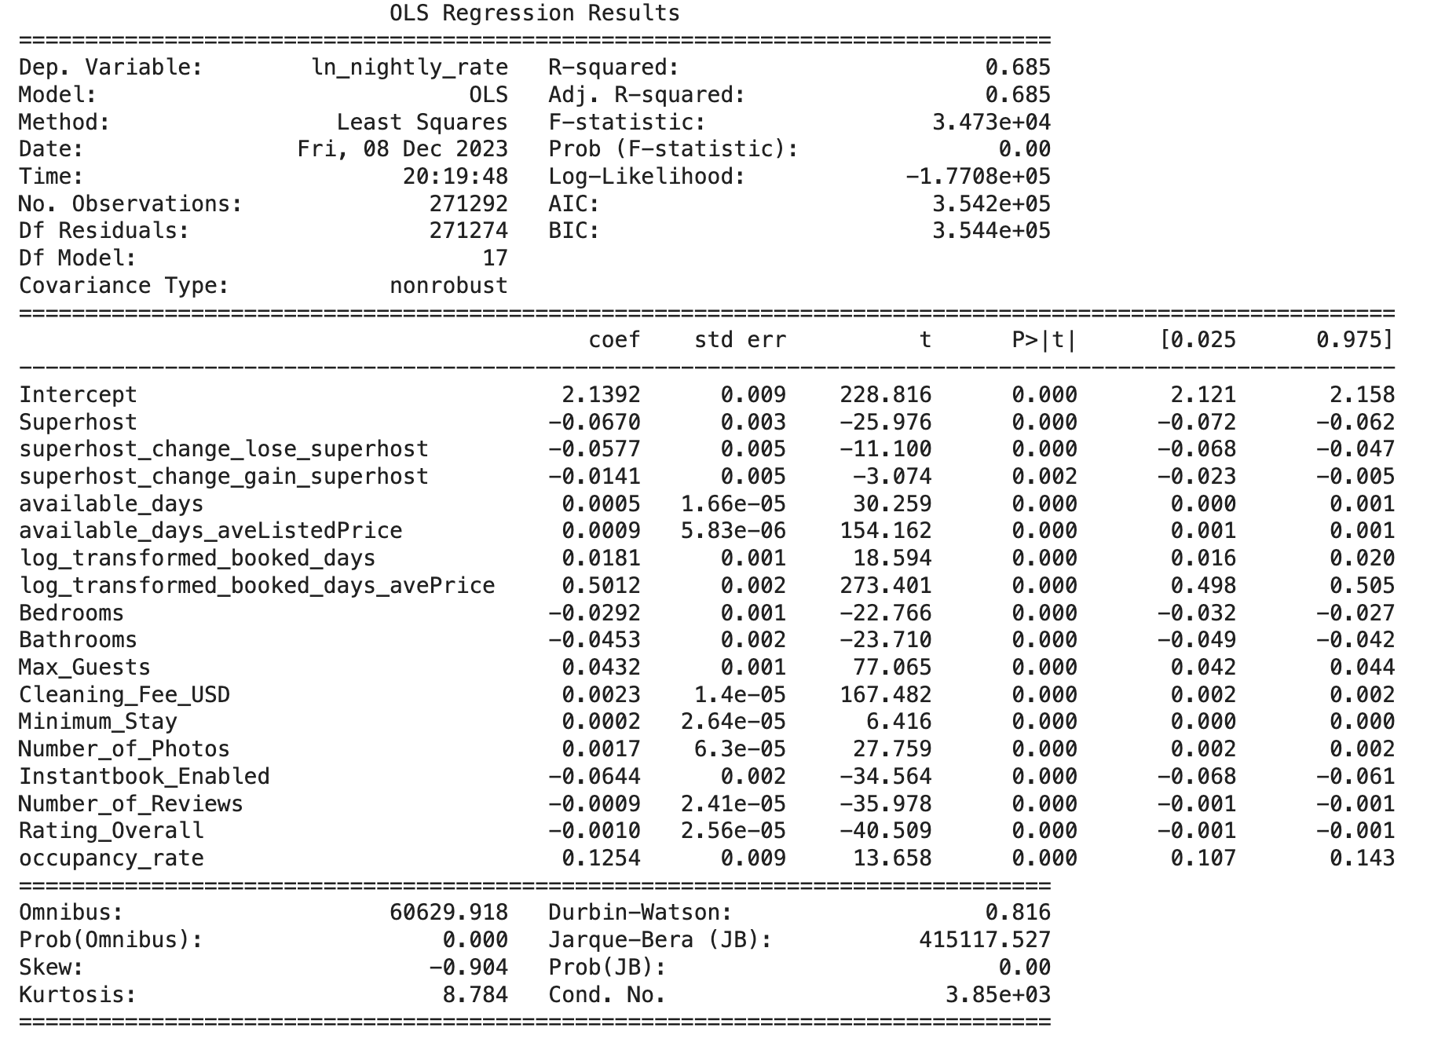
Model 2: Nightly Rates without categorical variables

Slide 23
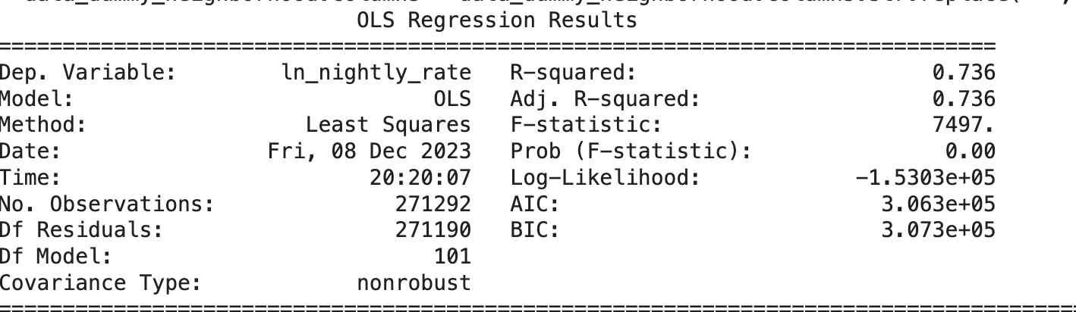
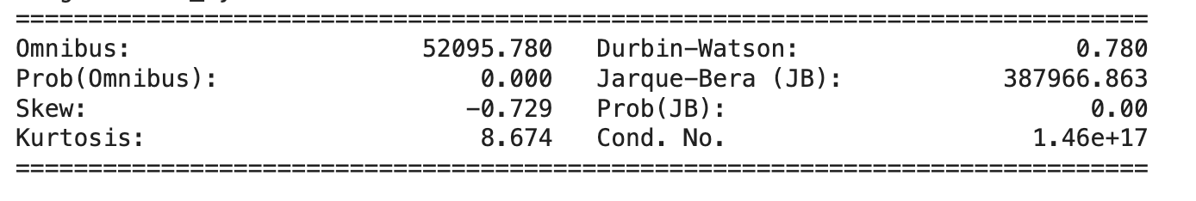
Model 3: Nightly Rates with Categorical Variables

Slide 24
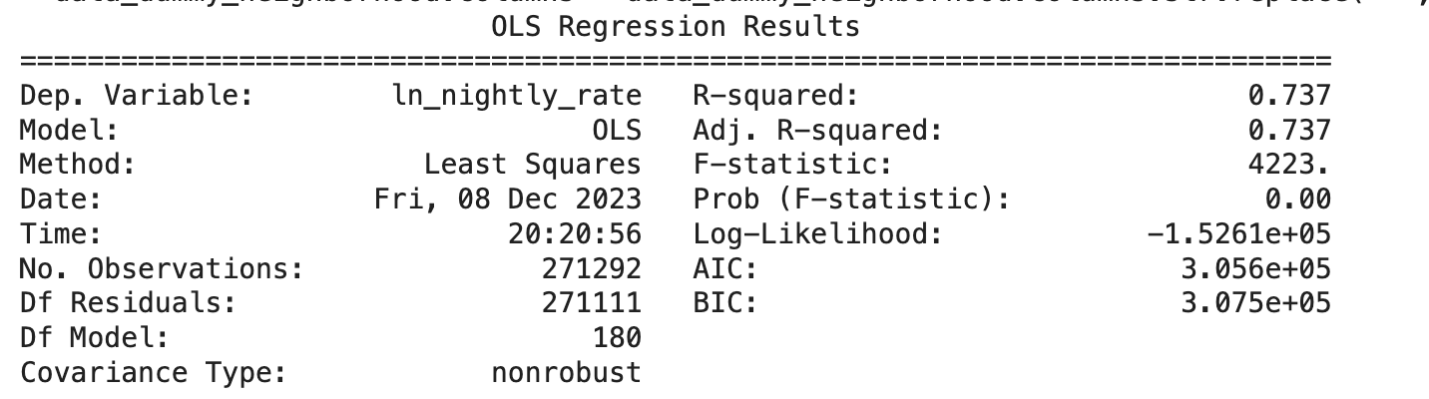
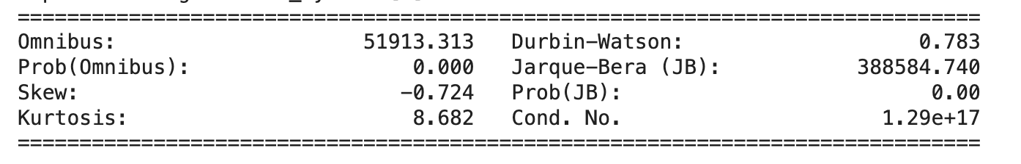
Model 4: Interaction Effects (Final Model)

Slide 25
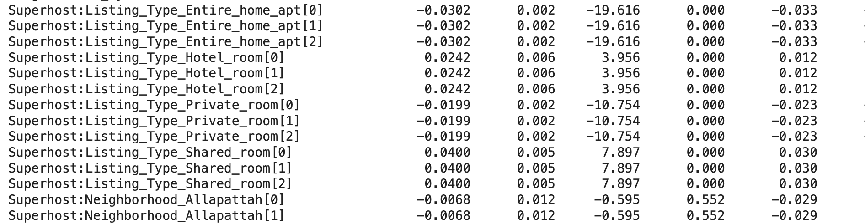
Final Model Results (Short sample with lag terms)

Slide 26
Interpretation of Results
Our model explains 73.7% of variability in nightly rate
Shows superhost is significant in determining pricing
Gaining superhost status has a negative effect on price
Interaction effects with superhost seem to have majority negative effect on price
Occupancy Rate Interpretation Example: A 1% increase in occupancy rate is associated with a 14% increase in nightly rate
Significant interaction effects on price (Large Magnitudes):
Superhost:Listing_Type_Entire_home_apt
Superhosts in Three Lakes and Brownsville
Notes:
Superhosts with entire hosts or apartments have a significantly negative effect on nightly rates and superhosts in three lakes and brownsville neighborhoods have a significantly negative effect on nightly rates as well.

Slide 27
Final Recommendations (Magnitude and Significance)
Where Superhosts can increase prices effectively:
High occupancy rates
Neighborhoods Three Lakes and Brownsville
Entire Home/ apartments
Results suggest increasing prices for Superhosts with high occupancy rates in general will increase revenue
Specifically Superhosts with entire homes/ apartments
Implications: Higher revenue for superhosts, competitive repositioning, changes in booking behavior

Slide 28
Future Recommendations for Testings
Test other cities
Test census variables
Run alternative models
Find others ways to reduce multicollinearity
Figuring out how to maximize revenue for Superhosts

Slide 29
References
https://colab.research.google.com/drive/1hg68LOAB_Ddrt4WbdIIv3SIrn84Awi7e?usp=sharing
https://chat.openai.com/share/dcb16ac8-b638-4003-a909-f9c9ac60119d
https://chat.openai.com/share/967f0da4-e91b-4415-a635-09c9100059d8
https://www.statista.com/chart/18963/most-popular-us-cities-for-airbnb-homeaway/
https://davidanthonyscott.medium.com/is-being-an-airbnb-superhost-worth-it-we-think-not-c0663bfc9e71
https://community.withairbnb.com/t5/Hosting/How-To-Tell-If-Your-Prices-Are-Too-Low/td-p/922607
https://colab.research.google.com/drive/1bA8ukTrUbrk8d7QuCqP1MR1GpkSnmqpO#scrollTo=yL5a-7fBSeJU

Slide 30
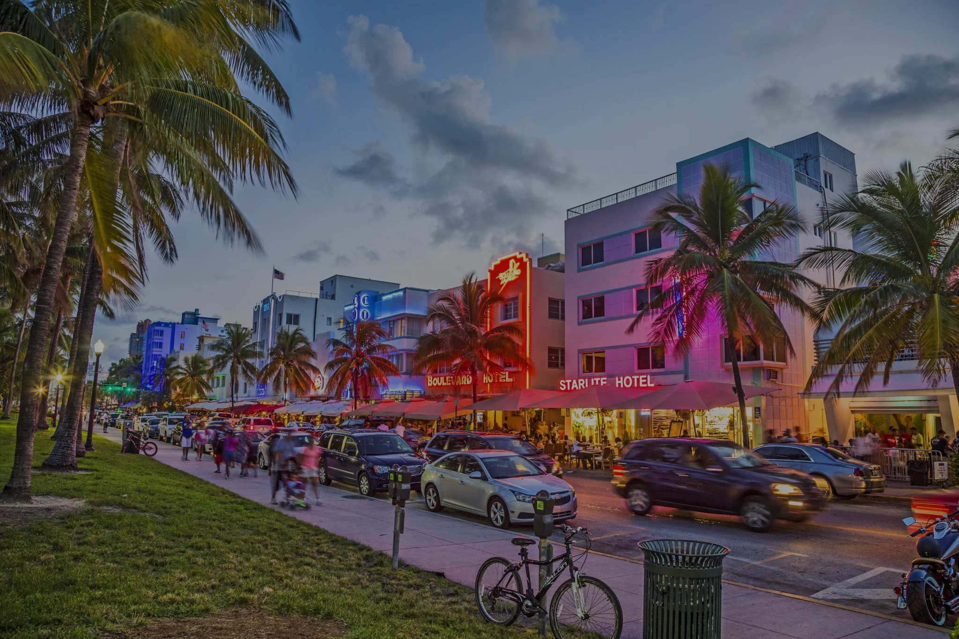
Thank You!

